Slide 1



















GOVERNMENT SECTOR

Slide 2
















GOVERNMENT SECTOR

Slide 3


GOVERNMENT SECTOR

Slide 4














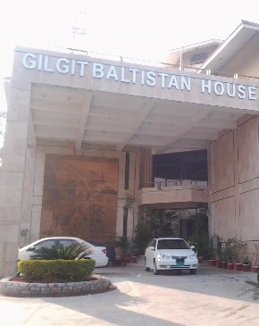





PRIVITE SECTOR

Slide 5









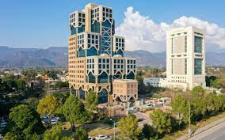









Private sector

Slide 6




















Private sector

Slide 7














Private sector

Slide 8







MILTRY SECTOR

Slide 9


















Restaurants and food

Slide 10





Restaurants and food

Slide 11




















School and university section

Slide 12













School and university section

Slide 13














Hospital and pharmacy

Slide 14










Hospital and pharmacy

Slide 15












NGO and Trust

Slide 16


Banks

